Slide 1
Evaluate Network Security Capabilities
CompTIA Security+ Exam SY0-701
Lesson 9

Slide 2
Network Security Baselines
Lesson 9
Topic 9A

Slide 3
Benchmarks and Secure Configuration Guides
Secure baseline
  Collection of standard configurations and settings for operating systems, network devices, software, cloud instances, patching and updates, access controls, logging, monitoring, password policies, encryption, endpoint protection, and many others
Center for Internet Security (CIS)
Security Technical Implementation Guides (STIGs)
Vendor provided guidance

Slide 4
Benchmarks and Secure Configuration Guides
Configuration management
Help manage, deploy, and measure compliance with established secure baselines
  Puppet
  Chef
  Ansible
Security Content Automation Protocol (SCAP)
  OpenSCAP
  CIS-CAT Pro
  SCAP Compliance Checker (SCC)

Slide 5
Switches and Routers
Examples of changes designed to improve security:
Change Default Credentials
Disable Unnecessary
Use Secure Management Protocols
Implement Access Control Lists (ACLs)
Enable Logging and Monitoring
Configure Port Security
Strong Password
Physically Secure Equipment

Slide 6
Server Hardware and Operating Systems
Examples of changes designed to improve security:
    Change Default Credentials
    Disable Unnecessary Services
    Apply Software Security Patches and Updates Regularly
    Least Privilege Principle
    Use Firewalls and Intrusion Detection Systems (IDS)
    Secure Configuration using CIS or STIG baselines
    Strong Access Controls
    Enable Logging and Monitoring
    Use Antivirus and Antimalware Solutions
    Physical Security of server equipment racks, server rooms, and datacenters

Slide 7
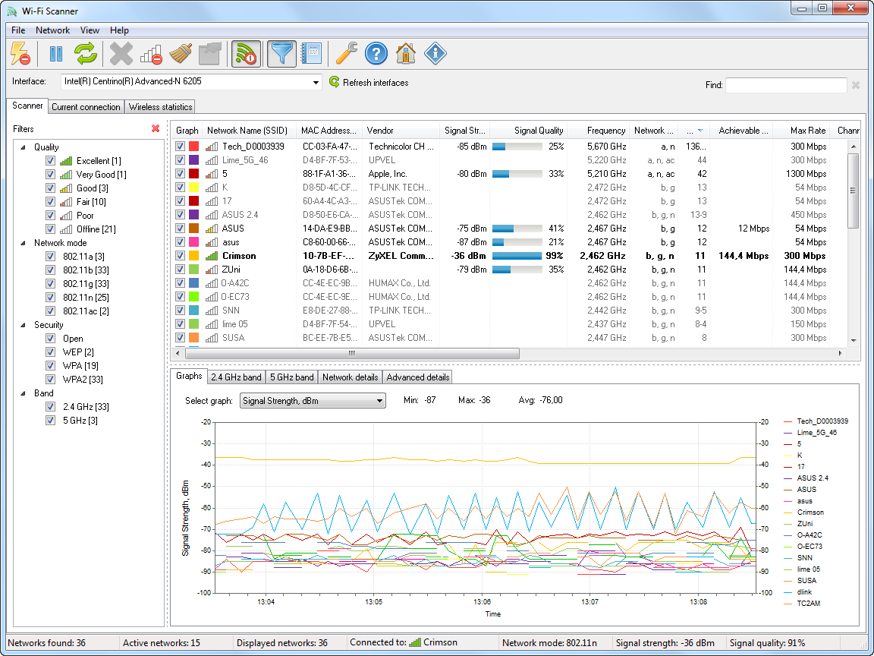
Wireless Network Installation Considerations
Wireless Access Point (WAP) Placement
Site Surveys and Heat Maps
Example output from Lizard System's Wi-Fi Scanner tool. (Screenshot courtesy of Lizard Systems.)
Notes:
A site-survey helps to identify weak signal coverage zones as well as innappropriate areas of coverage - such as strong signals covering external locations not used by employees and staff.

Slide 8
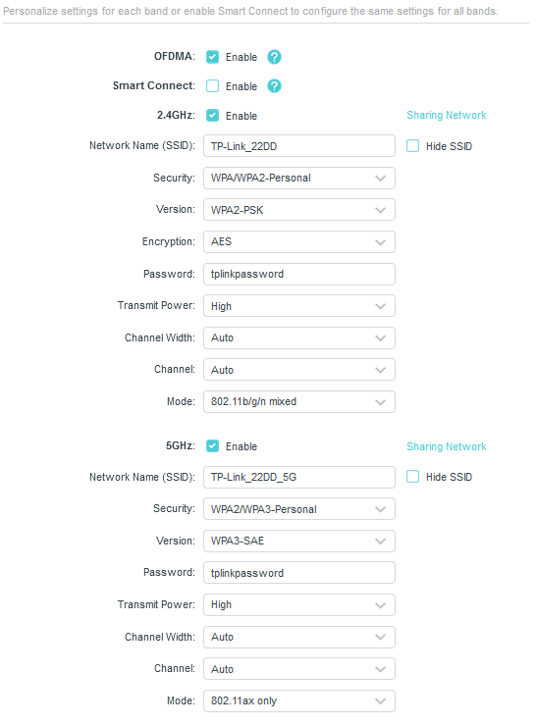
Wireless Encryption
Open
WEP
WPS
WPA & WPA2
WPA3
  Device Provisioning Protocol (DPP) a.k.a. “Easy Connect” to replace WPS
  Simultaneous Authentication of Equals (SAE)
  Enhanced Open
Configuring a TP-LINK SOHO access point with wireless encryption and authentication settings. In this example, the 2.4 GHz band allows legacy connections with WPA2-Personal security, while the 5 GHz network is for 802.11ax (Wi-Fi 6) capable devices using WPA3-SAE authentication. (Screenshot used with permission from TP-Link Technologies.)
Notes:
Equipment that cannot be patched to protect against the KRACK (WPA2) and REAVER (WPS) exploits must be decommissioned.

Slide 9
Wi-Fi Authentication Methods
WPA2 Pre-Shared Key Authentication
WPA3 Personal Authentication
WPA2/WPA3-Enterprise
  RADIUS
  EAP

Slide 10
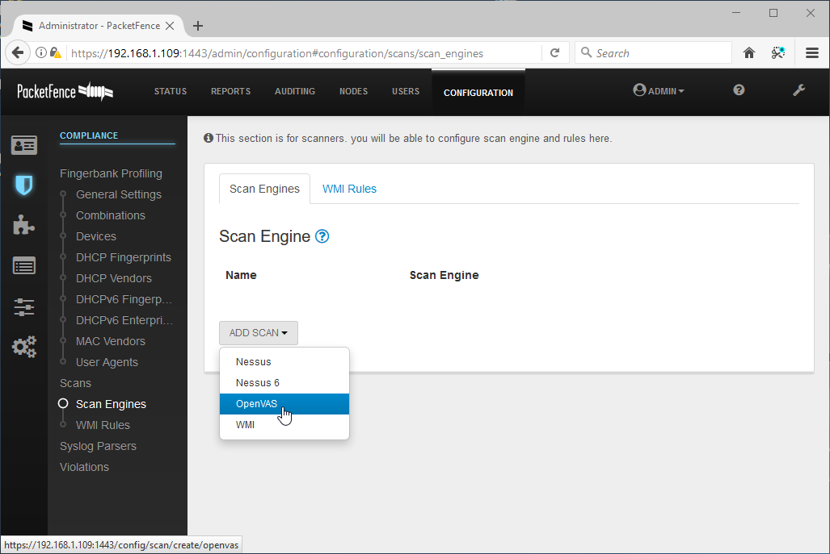
Network Access Control
Authenticates users/devices before allowing them access to the network
Agent versus agentless
PacketFence supports the use of several scanning techniques, including vulnerability scanners, such as Nessus and OpenVAS, Windows Management Instrumentation (WMI) queries, and log parsers. (Screenshot used with permission from packetfence.org.)

Slide 11
Network Security Baselines
Benchmarks and Secure Configuration Guides
Wireless Network Installation Considerations
Wireless Encryption
Wi-Fi Authentication Methods
Network Access Control
Notes:
Take some time at the end of each topic to answer questions. You can use the review questions for discussion in class or set them for students to complete individually during or after class.

Slide 12
Assisted Lab: Understanding Security Baselines

Slide 13
Network Security Capability Enhancement
Lesson 9
Topic 9B

Slide 14
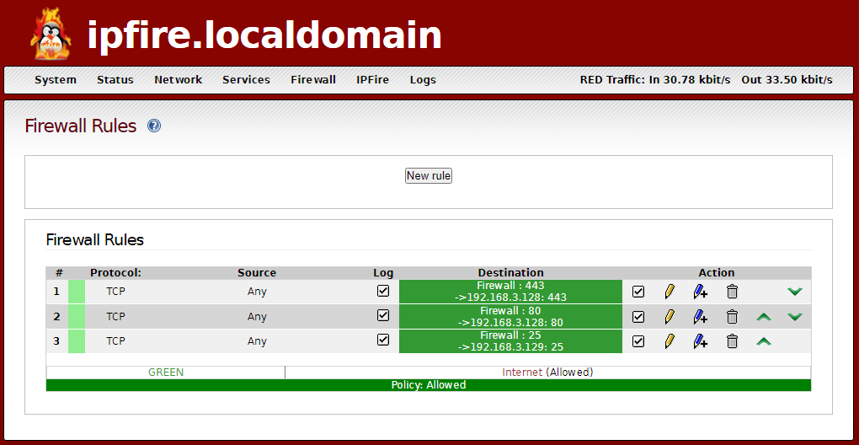
Access Control Lists
ACL
  List of permissions associated with a network device, such as a router or a switch, that controls traffic at a network interface level
Firewall Rule
  Dictates how inbound or outbound network traffic for specific IP addresses, IP ranges, or network interfaces
Screened Subnet
  A neutral zone, separating public-facing servers from sensitive internal network resources
Sample firewall rules configured on IPFire. This ruleset allows any HTTP, HTTPS, or SMTP traffic to specific internal addresses. (Screenshot used with permission from IPFire)

Slide 15
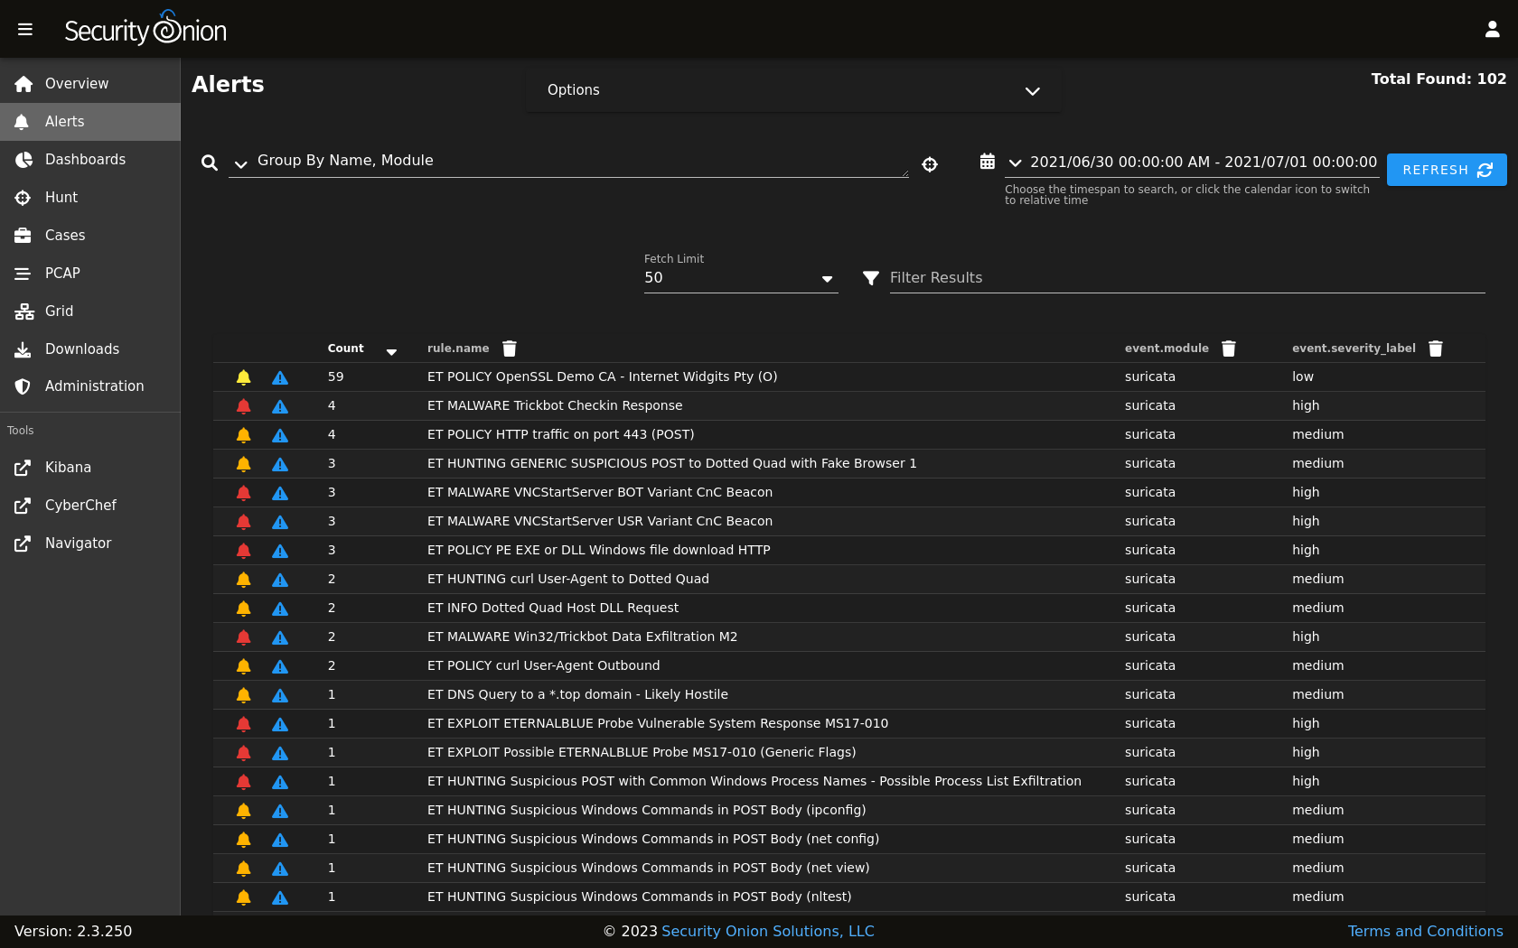
Intrusion Detection and Prevention Systems
Host-based
Network-based
Both look for suspicious patterns or activities that could indicate a network or system intrusion
They differ in their responses to perceived threats
Snort
Suricata
OSSEC
The Security Onion Alerts dashboard displaying several alerts captured using the Emerging Threats (ET) ruleset and Suricata. (Screenshot used with permission from Security Onion.)
Notes:
An excellent description and breakdown of Snort rules is available at https://snort.org/documents#OfficialDocumentation.

Slide 16
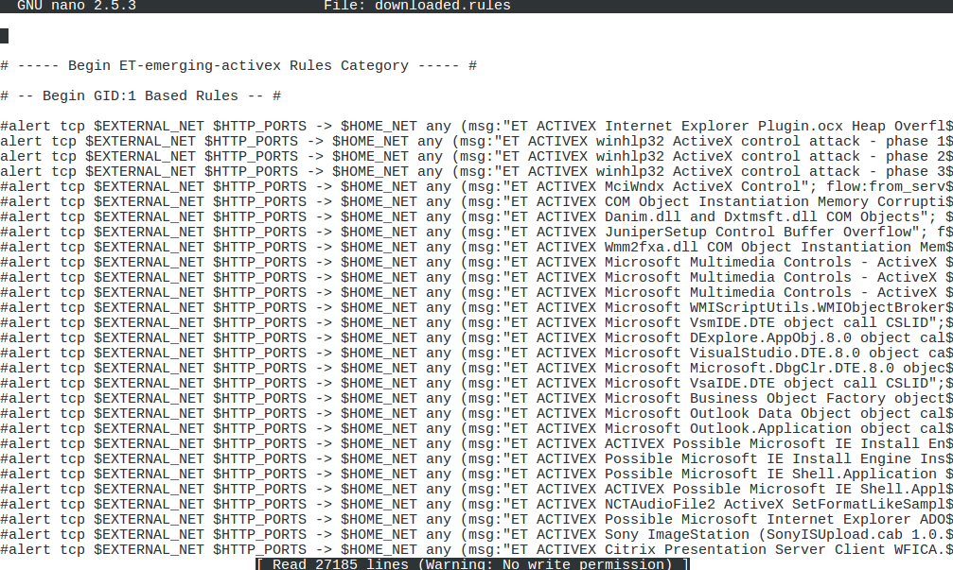
IDS and IPS Detection Methods
Signature-Based Detection
Anomaly-based detection
Trend Analysis
Behavioral-based detection
  Network Behavior and Anomaly Detection (NBAD)
  User and Entity Behavior Analytics (UEBA)
Snort rules file supplied by the open-source Emerging Threats community feed.

Slide 17
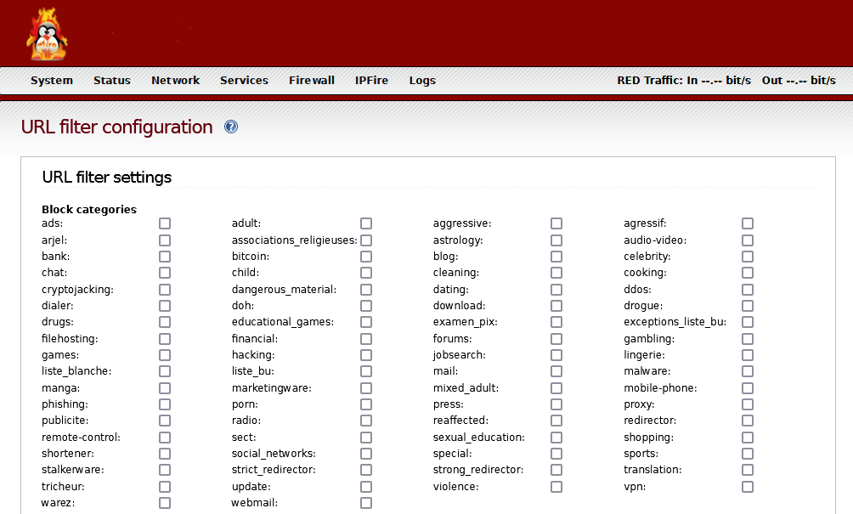
Web Filtering
Block users from accessing malicious or inappropriate websites
Enforce compliance with acceptable use
Block malware
Protection from phishing attacks
Agent-Based Filtering
Centralized Web Filtering
URL Scanning
Content Categorization
Block Rules
Reputation-Based Filtering
Decrypting and inspecting HTTPS traffic
Web filter content categories using the IPFire open-source firewall. (Screenshot used with permission from IPFire.)

Slide 18
Network Security Capability Enhancement
Access Control Lists
Intrusion Detection and Prevention Systems
IDS and IPS Detection Methods
Web Filtering
Notes:
Take some time at the end of each topic to answer questions. You can use the review questions for discussion in class or set them for students to complete individually during or after class.

Slide 19
Applied Lab: Implementing a Firewall

Slide 20
Summary
CompTIA Security+ Exam SY0-701
Lesson 9

